Slide 1
About AGB: Vision, Mission, Values, Membership
~DELETE THIS BOX BEFORE USING~
This collection of slides can be used to augment a wide variety of presentations on AGB and governance.
It is not meant to be a single presentation. You can copy/paste any of these slides into your own presentation.

Slide 2
About AGB
Based in Washington, DC and founded in 1921
Membership: 2,000 higher education institutions, systems, and foundations; 40,000 individuals
We help our members:
  Understand governance
  Work collaboratively to oversee the institution
  Lead through strategic challenges and opportunities

Slide 3


AGB Members by the Numbers
2,000
Institutions, Systems, and
Foundations
40,000
Individual Board Members
Our member boards oversee
10 million students
(FTE)

Slide 4
AGB — What We Stand for
Vision:
Achieve excellence in all board governance and responsible trusteeship to empower vibrant higher education, inclusive democracy, and a flourishing society.
Mission:
AGB advances higher education as a public good by preparing college, university, and foundation governing boards to fulfill their fiduciary duties and exemplify the highest ideals of trusteeship.
Values:
Innovation, integrity, inclusivity, service, collaboration, and respect

Slide 5
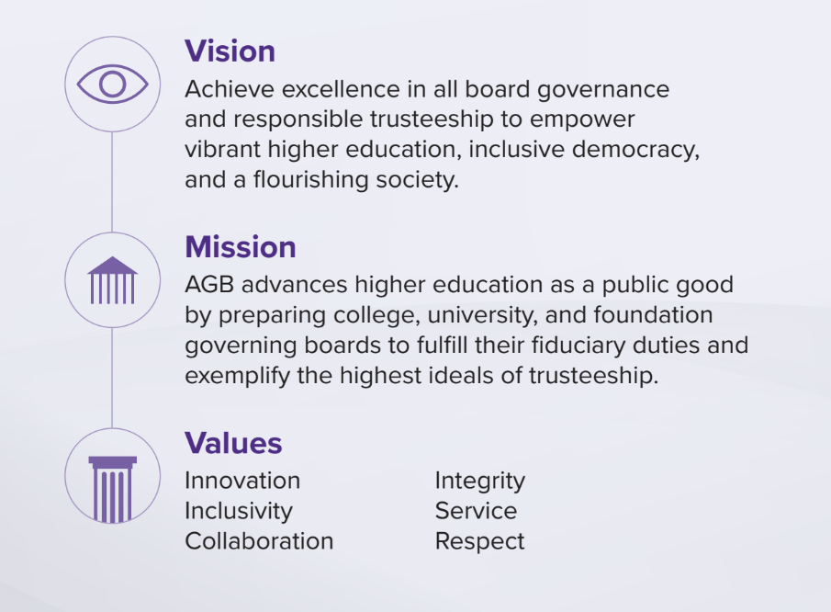
What We Stand For

Slide 6
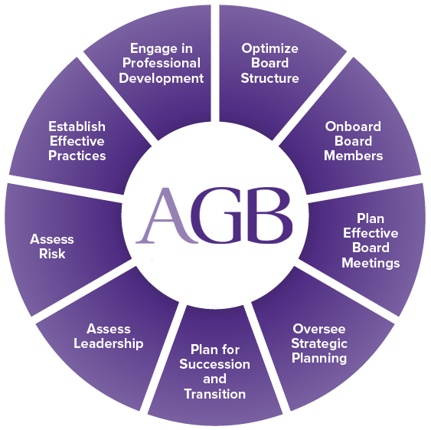
How AGB supports boards

Slide 7
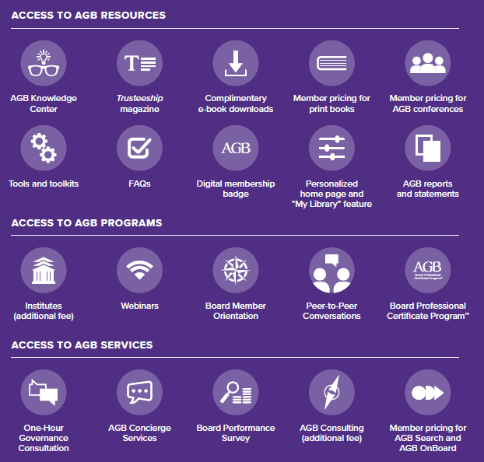
AGB Member Benefits

Slide 8
Top Strategic Issues
2024–2025

Slide 9




Top Strategic Issues 2024–2025
What is the role of the board in understanding and addressing these complex challenges and opportunities in ways that make sense for institutions, systems, and foundations?
https://agb.org/product/top-strategic-issues-for-boards-2024-2025

Slide 10
What is the role of the board?
Embrace board independence—even in the face of political, legislative, or other outside pressure—and trustees’ responsibility to act in their institution’s best interest.
Build a relationship of trust and mutual support with the president.
Discuss and decide, before a crisis, how the board empowers or backs the president in cases of public stances or freedom of speech issues.
Use orientation, regular assessment, and continuing board education to ensure board members share a cohesive understanding of principles of trusteeship and good governance.

Slide 11

What is the role of the board?
Have a leadership transition plan in place before there is a need;
be ready to search for and select the best candidate to lead the institution.
Provide regular assessment and coaching and development opportunities, with constructive feedback to support presidents and CEOs in what are increasingly difficult positions.
Cultivate future leaders at the provost and cabinet level to create a leadership pipeline.
Ensure that board members have, or get, the education and skills to fill future chair or committee positions. Search for new volunteers strategically.
Prepare a succession plan for the board professional role, which is critical as a line of communication between leadership and the board and for the preservation of institutional knowledge.

Slide 12

What is the role of the board?
Design a student-centered, user-friendly experience from enrollment to graduation, leveraging trustees’ business and corporate experience.
Have a clear understanding on what student success metrics are and should be.
Ensure that offerings meet students’ desire for career preparation and job skills alongside traditional academics. Make sure the return on investment is clear.
Request metrics to understand the diversity of the student body and use an equity lens in all decision-making.
Understand what institutional policies are and should be in place to foster student safety, democratic citizenship, and respectful and honest conversations on campus.

Slide 13

What is the role of the board?
Understand and anticipate how advances in artificial intelligence (AI) and other technologies affect teaching, learning, and other processes, and specific opportunities and challenges for your institution.
Use technology and data responsibly and ethically to improve the student experience through recruitment, retention, and graduation.
Work with leadership to re-examine the institution’s business model, conduct market research, and embrace innovation.
Be aware of how innovative partnerships, mergers, or affiliations can help an institution’s financial model while increasing the value proposition.

Slide 14
Board Structure, Culture, and Miscellaneous

Slide 15
Distinctions between corporate and higher education boards
Public Corporations
Maximize shareholder value
Stakeholders: mostly shareholders
Public Colleges and Universities
Serve educational and public service mission
Stakeholders: students, faculty, staff, alumni, lawmakers, public…
Performance metrics: broad
Performance metrics: mostly financial

Slide 16
Board Structure
Board Composition
Priorities
What are our priorities?
Committee Structure
What committees do we need?
Board size
Skillsets, experiences, backgrounds
What do we discuss in executive session?
What staff should support?
When do we need information from management?

Slide 17
Healthy vs Unhealthy Boards
Healthy
Unhealthy
Distributed Influence
Open-minded Listeners
Constructive Dissent
Collective Wisdom
Transparency
Dominant Inner Circle
Close-minded Speakers
Back-channel Agitation
Individual Convictions
Opacity
Adapted from “The Bedrock of Board Culture,” by Richard Chait. Trusteeship Magazine, 2016

Slide 18
Healthy vs Unhealthy Boards
Healthy
Unhealthy
Confidentiality
Respect and Trust
Clear Expectations
Diligence
Mutual Accountability
Seepage
Disregard and Distrust
Ambiguous Expectations
Disengagement
Collective Immunity
Adapted from “The Bedrock of Board Culture,” by Richard Chait. Trusteeship Magazine, 2016

Slide 19
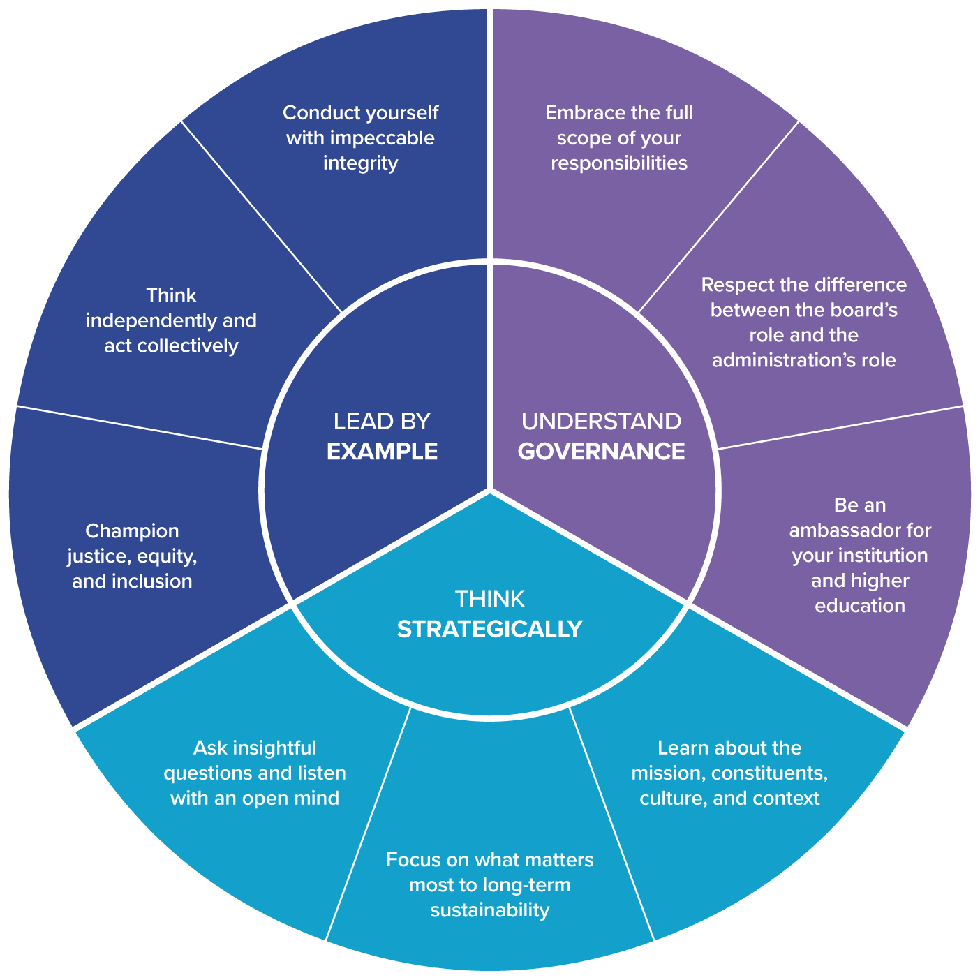
Principles of Trusteeship for Individuals

Slide 20

Ten Habits of a Highly Effective Board
5. Establish a strong governance committee.
4. Select an effective board chair.
3. Cultivate a healthy relationship with the president.
2. Uphold basic fiduciary duties.
1. Create a culture of inclusion.

Slide 21
Ten Habits of a Highly Effective Board
10. Focus on accountability.
9. Develop a renewed commitment to shared governance.
8. Provide appropriate oversight of academic quality.
7. Consider strategic risk factors.
6. Delegate appropriate decision-making authority to committees.

Slide 22
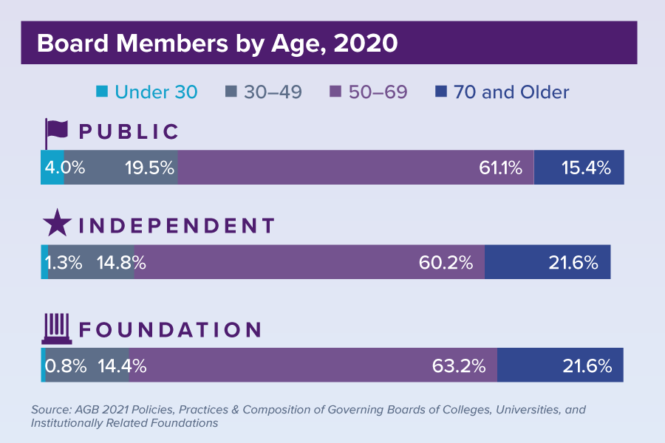
Governing Board Stats

Slide 23
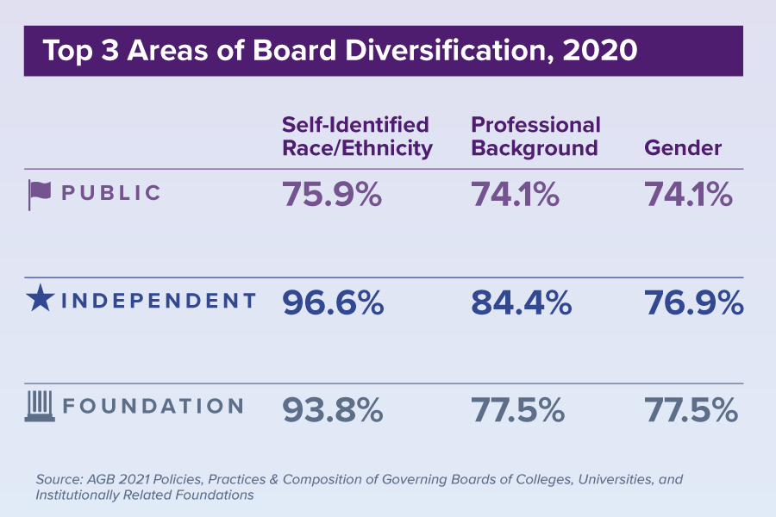
Governing Board Stats

Slide 24
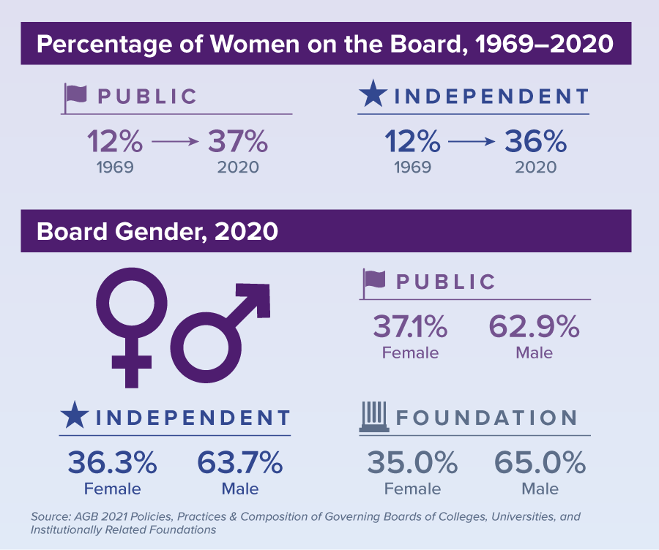
Governing Board Stats

Slide 25
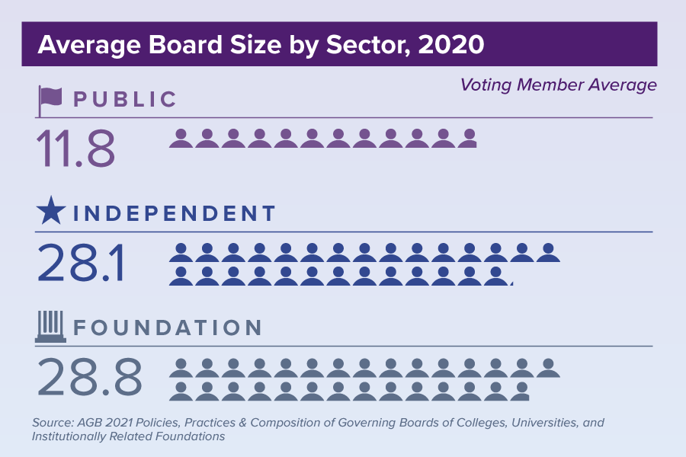
Governing Board Stats

Slide 26
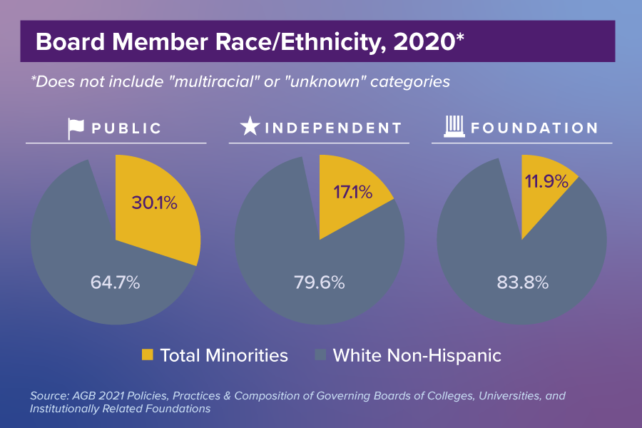
Governing Board Stats

Slide 27

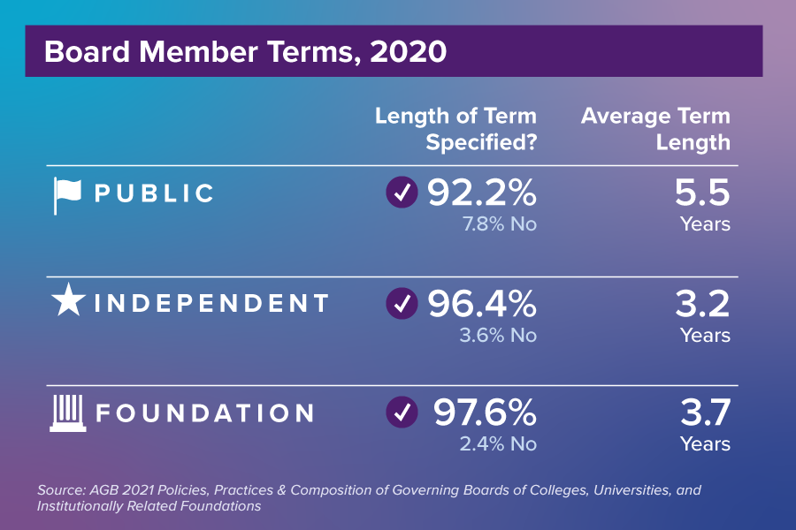
Governing Board Stats

Slide 28
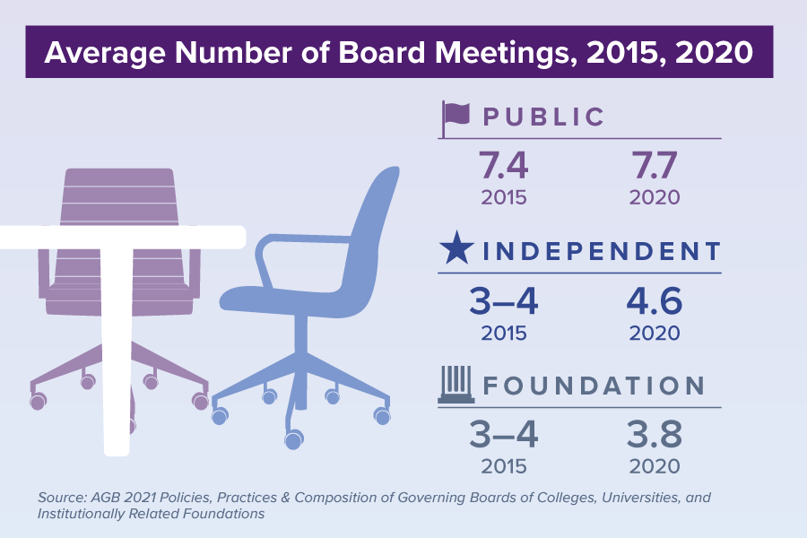
Governing Board Stats

Slide 29
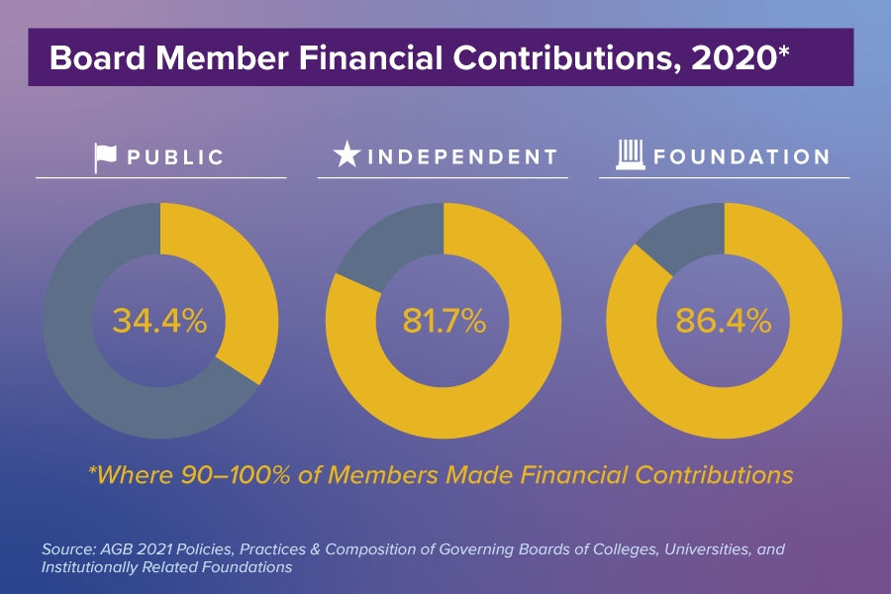
Governing Board Stats

Slide 30


Slide 31
An AGB Quick Take

